Slide 1
Apple stock forecasting
TEAM-5
TEAM MEMBERS
Mr.Vishwanath M Irkal
Mr.Rahul S Shalgar
Kasbe Amol Sahebrao
RUPALI SHARMA
Mrs. Lavanya Nalla
Mr.Akash Reddy
Project Trainer : Neha Gupta

Slide 2
Introduction
In this project, we have explored the dynamics of stock prices over time and developed a model to predict the prices for the next 30 days. The goal of this project was to provide investors and traders with a reliable tool for making informed decisions and maximizing their returns. The stock market is a complex and dynamic system, influenced by a wide range of factors such as global events, economic indicators, and company news. Therefore, accurate forecasting of stock prices is a challenging task that requires advanced analytical tools and techniques. In this presentation, I will walk you through the methodology I used for this project, the dataset I analyzed, the results I obtained, and the implications of my findings. I hope this presentation will be informative and engaging, and I look forward to hearing your feedback. Thank you."

Slide 3
Problem statement
Predict the apple stock price for next 30 days. There are Open, High, Low and Close price given for each day starting from 2012 to 2019 for Apple stock.

Slide 4
About the dataset
"For this project, we were provided with a dataset by our institution. The dataset contained historical stock prices of a Apple company. The dataset included daily stock prices for several years, along with other variables such as trading volume, opening and closing prices. We used this dataset to develop and evaluate our time series model for forecasting the stock price for the next 30 days. We acknowledge the contribution of our institution in providing us with this dataset, which was instrumental in the success of our project."

Slide 5
methodology used for forecasting
"We evaluated several time series models for forecasting the stock price, including ARIMA, SARIMA, and Holt-Winters. We compared the performance of each model by measuring the Mean Absolute Percentage Error (MAPE) on the test dataset. Our analysis showed that while ARIMA and SARIMA performed reasonably well, the Holt-Winters method outperformed them with the lowest MAPE value. This suggested that the Holt-Winters method was better suited for our dataset, as it was able to capture the trend and seasonality in the data more accurately. Additionally, we found that the Holt-Winters method was easy to interpret and implement, making it a practical choice for our project. Therefore, we selected the Holt-Winters method for forecasting the stock price for the next 30 days."

Slide 6
Table shows different errors for different models
Models | p,d,q | P.D.Q | seasonal period | MAE | MAPE | RMSE | AIC
ARIMA | 0,1,0 | - | - | 26.47 | 12.26 | 35.72 | -8995.62
 | 1,1,1 | - | - | 26.47 | 12.26 | 35.72 | -8995.62
SARIMA | 1,1,1 | 0,1,0 | 21 | 890.99 | 491.82 | 1216.07 | -7687.191
 | 1,1,1 | 0,1,1 | 21 | 24.76 | 16.76 | 28.99 | -8747.49
 | 1,1,1 | 0,1,1 | 63 | 25.39 | 17.86 | 29.7 | -8406.051
 | 1,1,1 | 1,1,1 | 63 | 25.43 | 17.22 | 29.81 | -8404.825
 | Alpha | Beta | Gamma | MAE | MAPE | RMSE | AIC
HOLT WINTERS | 0.4 | 0.1 | 0.2 | 22.16 | 16.61 | 26.53 | -12651.727
 | 0.2 | 0.15 | 0.65 | 19.81 | 13.58 | 24.52 | -11499.031
 | 0.4 | 0.45 | 0.15 | 21.58 | 12.07 | 29.57 | -12592.571

Slide 7
Challenges Faced
"While evaluating different time series models for forecasting the stock price, we also attempted to implement the Seasonal Autoregressive Integrated Moving Average (SARIMA) model. However, we encountered challenges when dealing with the large dataset and 260 periods of seasonality. Due to the size of the dataset and the complexity of the SARIMA model, our machine was not able to handle the computational requirements, and we were unable to obtain the MAPE value for the SARIMA model. We tried various methods to optimize the model, such as reducing the size of the dataset or increasing the computing power, but these were not feasible options. As a result, we decided to explore other time series models, such as the Holt-Winters method, which were better suited for our dataset and could be implemented with our available resources. While we were not able to fully evaluate the SARIMA model, we learned valuable lessons about the importance of computational resources and the need to consider practical constraints when selecting a forecasting model."

Slide 8
Holt winters method
"The Holt-Winters method is a popular time series forecasting model that is used to capture both the trend and seasonality in the data. The method is based on the idea that future values of a time series are a function of its past values, as well as the trend and seasonality components. This involves applying three smoothing functions to the time series data: one for the level, one for the trend, and one for the seasonal component. The Holt-Winters method has three main parameters: alpha, beta, and gamma. Alpha controls the smoothing of the level component, beta controls the smoothing of the trend component, and gamma controls the smoothing of the seasonal component. These parameters are typically selected through a process of trial and error or using optimization techniques.

Slide 9
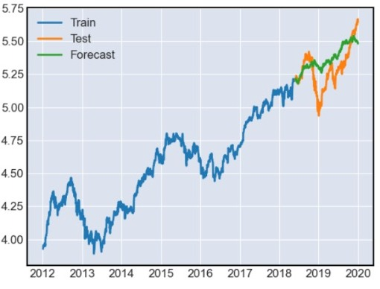
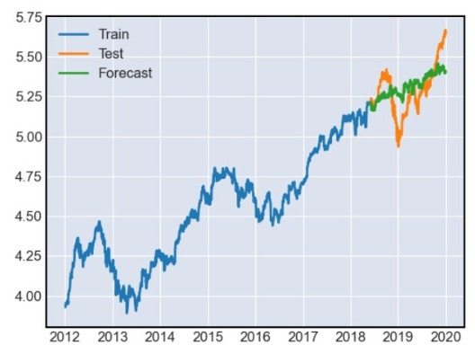
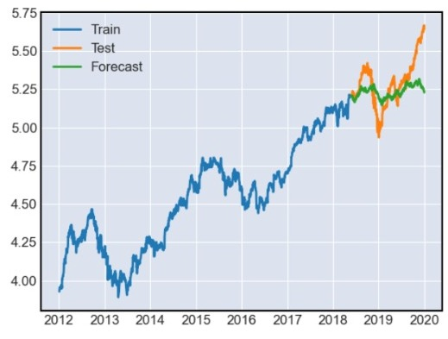
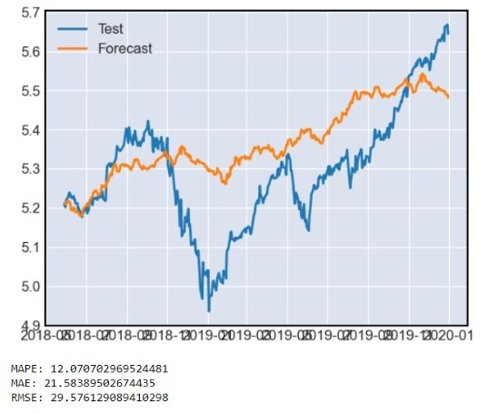
Final Model With Best parameters

Slide 10
Advantages
One of the main advantages of the Holt-Winters method is its ability to handle time series data with trend and seasonality, which are common features of financial data. It is also relatively easy to interpret and implement, making it a popular choice for forecasting in business and finance. Overall, the Holt-Winters method provides a robust and reliable approach to time series forecasting, which is suited for a wide range of applications. By carefully selecting the parameters and optimizing the model, we were able to obtain accurate forecasts for the stock price for the next 30 days."

Slide 11
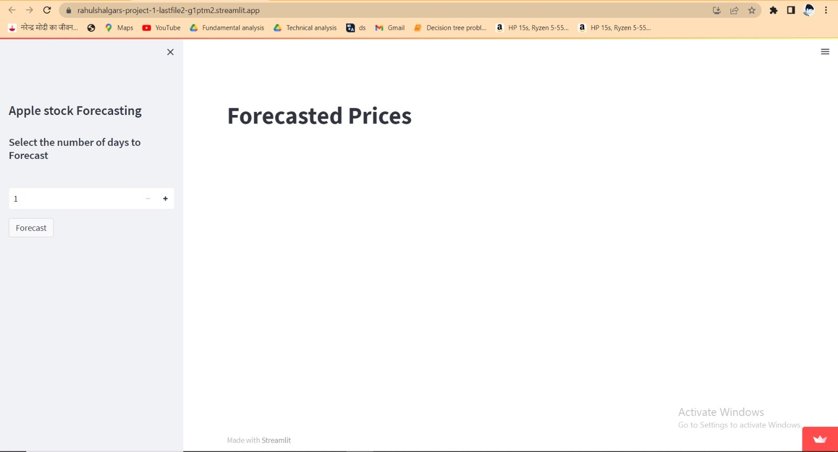
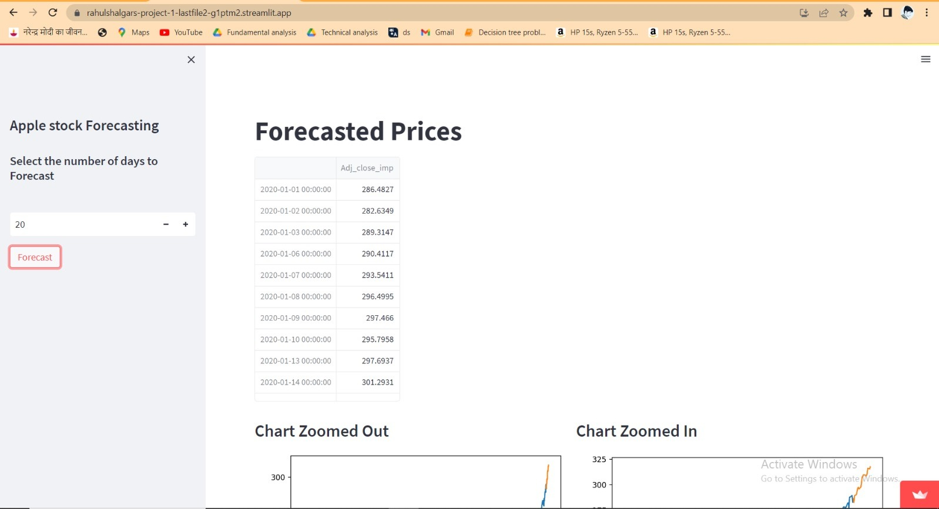
User interface created using Streamlit, explaining how users
can interact with it to obtain stock price forecasts

Slide 12
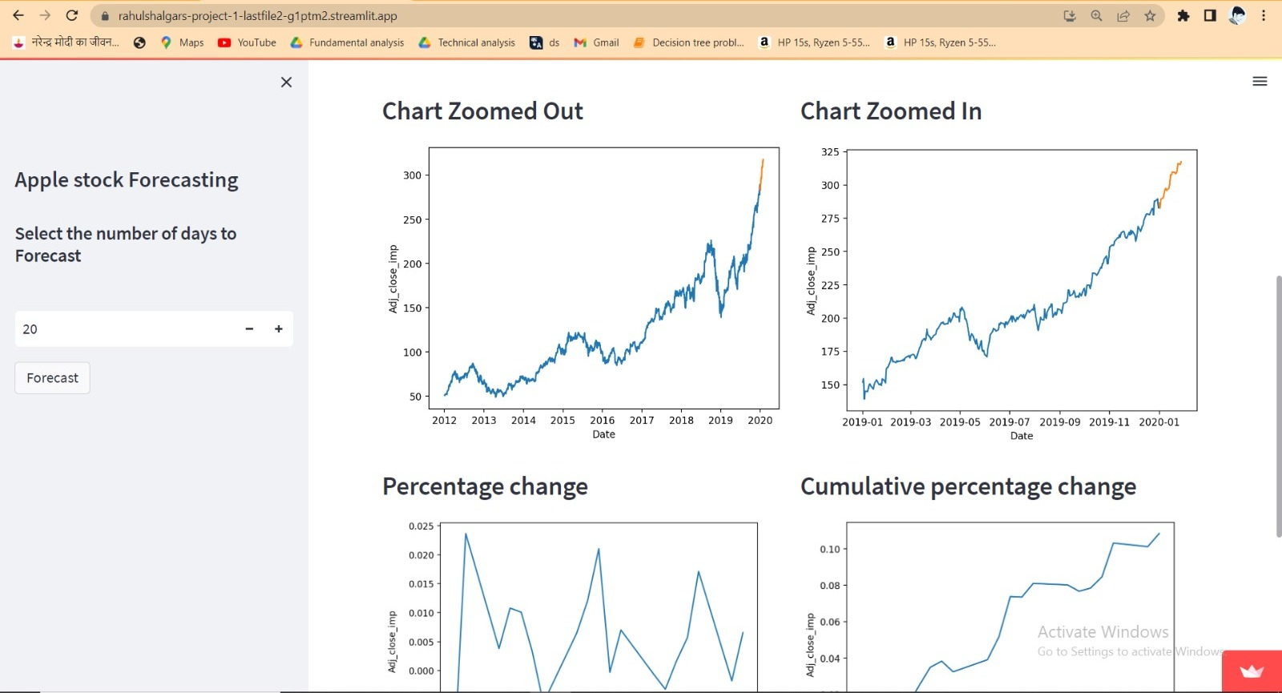
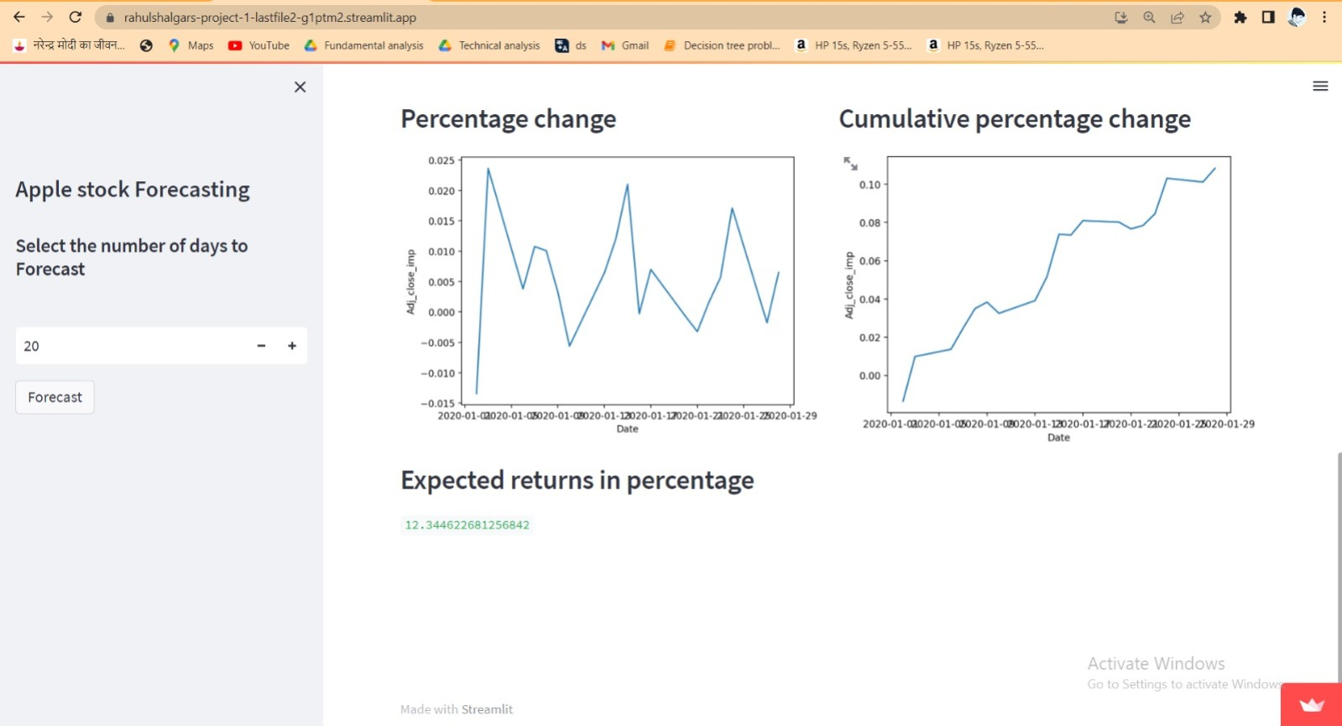
Link-
https://rahulshalgars-project-1-lastfile2-g1ptm2.streamlit.app/

Slide 13
Limitations of the model
Other time series forecasting methods, such as ARIMA and SARIMA, are also widely used and can provide accurate forecasts in certain contexts. These methods often require more expertise and computational resources than the Holt-Winters method, but can be useful when dealing with complex or non-stationary data.

Slide 14
Improving the model and user interface
However, there are opportunities for future improvements in both selecting the model(Holt-Winters method) and the user interface.. Improvement in the model could be to explore alternative forecasting models that are better suited for non-stationary data, such as machine learning algorithms. And when it comes to improve user interface we can we receive the feedback from users on its usability and functionality. This feedback can be used to make improvements to the interface, such as incorporating additional features or improving the visualizations. Additionally, user feedback can help identify areas where additional documentation or support may be needed to improve user adoption and satisfaction."

Slide 15
Acknowledgement
"I would like to express my sincere gratitude to our project trainer for their guidance and support throughout this project, as well as our mentors for their invaluable advice.
I would also like to extend my appreciation to the data providers for providing us with the necessary data to conduct our analysis.
Thank you all for your support and contributions to this project.

Slide 16
THANK YOU

